Slide 1

Really Reaching Human Parity? - Addressing Benchmark Issues on Robustness, Bias and Metric.
Qi Zhang (Fudan University), Nan Duan (Microsoft Research Asia), Ming Zhou (Sinovation)
ACL-2021 Workshop on Benchmarking: Past, Present and Future

Slide 2

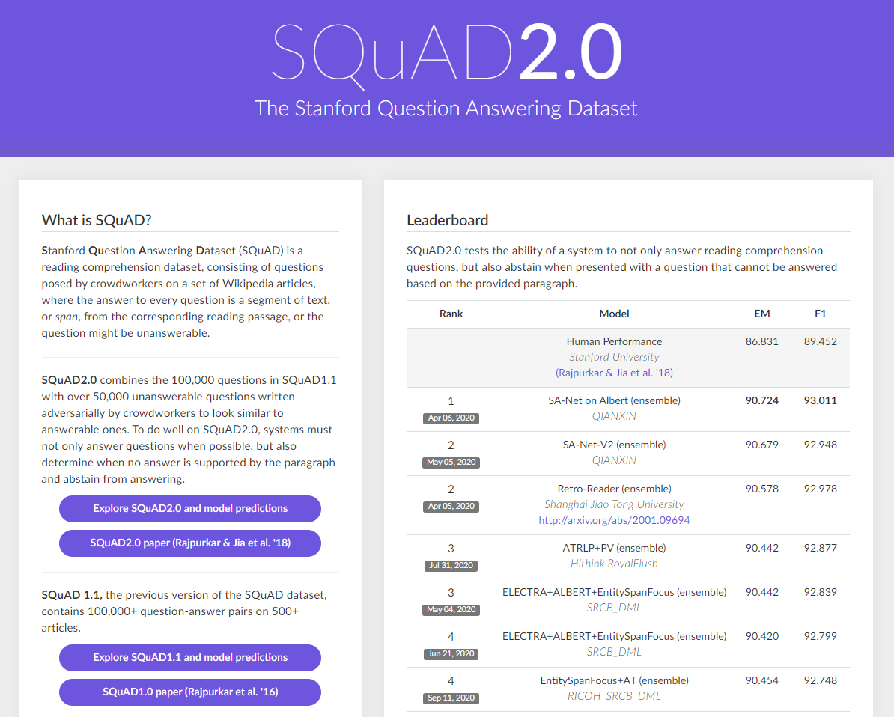

Benchmarks are significant for the growth of AI research.

Slide 3
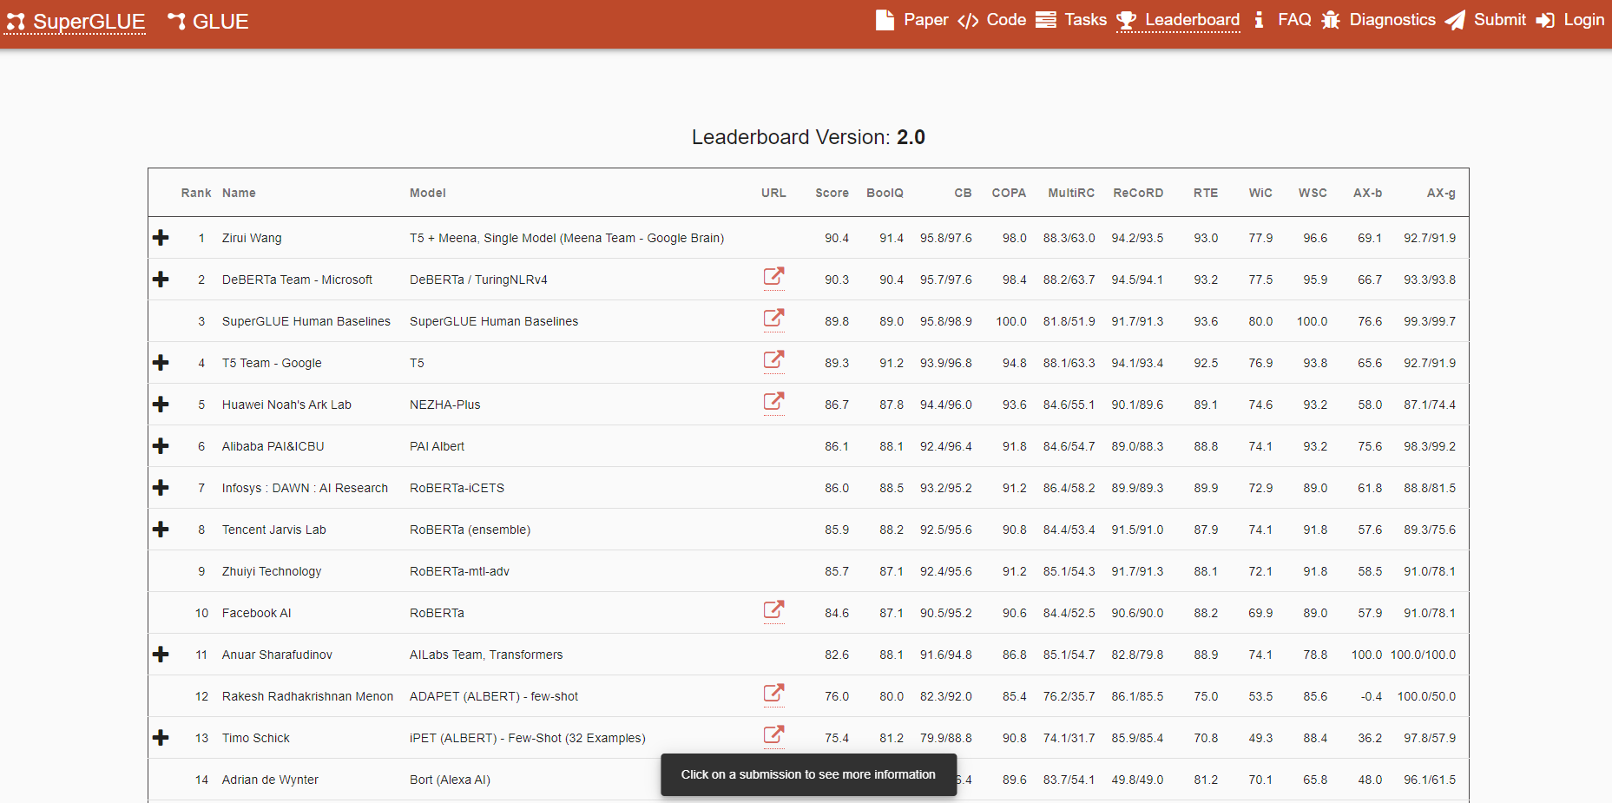
DNNs even achieved human parity on some famous ones!

Slide 4
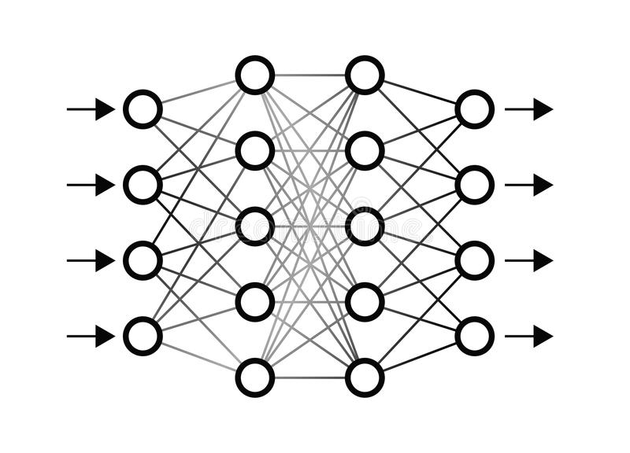



But are these benchmarks good enough for evaluating AI?
Neural Networks
Human

Slide 5
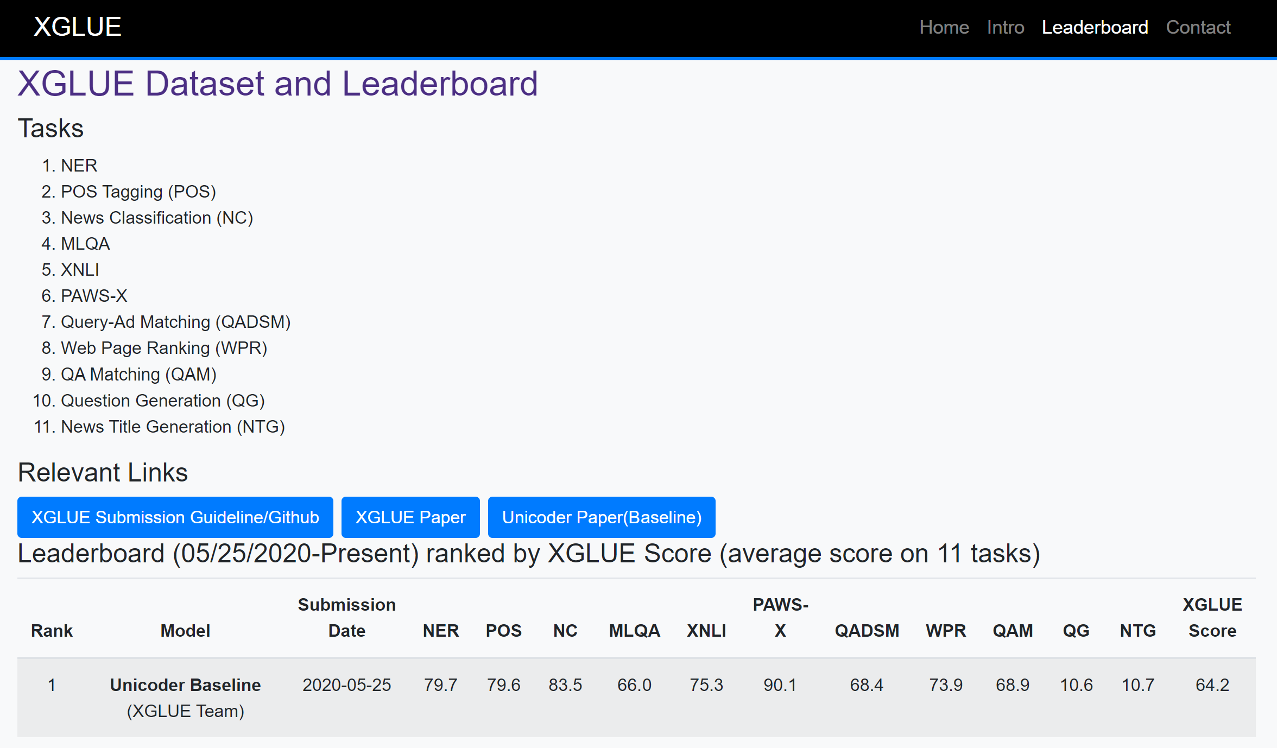
Take our dataset (i.e., XGLUE) as an example.
New Tasks!
https://microsoft.github.io/XGLUE/

Slide 6
(1) Robustness issue in XGLUE.
DNA profiling is today possible with even very small quantities of blood: this is commonly used in forensic science, but is now also part of the diagnostic process of many disorders…
Original question: where is DNA used today? -- forensic science
Modified question: where is RNA used today? -- forensic science
Modified question: where is DNA not used today? -- forensic science
In 1975, Bill Gates co-founded Microsoft with childhood friend Paul Allen in Albuquerque, New Mexico. It became the world's largest personal computer software company.
Original question: Who founded Microsoft? -- Bill Gates
Modified question: Who founded Apple? -- Bill Gates
Donald Knuth argues that ternary computers will be brought back into development in the future to take advantage of ternary logic‘s elegance and efficiency…
Original question: Who is a proponent of ternary computers? -- Donald Knuth
Modified question: Who is an opponent of ternary computers? -- Donald Knuth

Slide 7
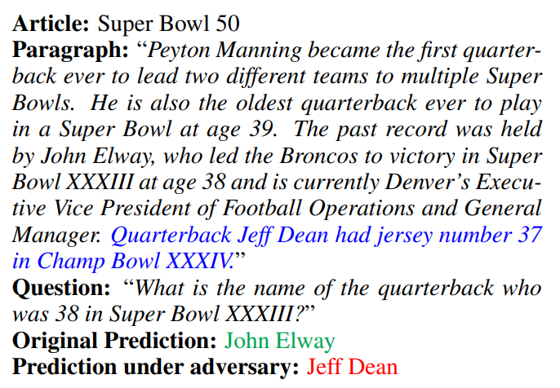
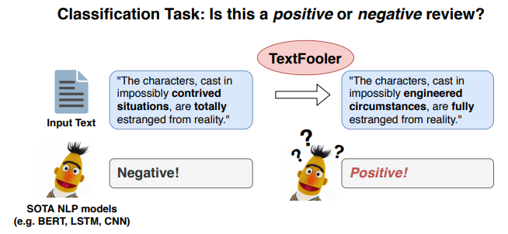
Similar findings in other datasets.
[1707.07328] Adversarial Examples for Evaluating Reading Comprehension Systems (arxiv.org)
[1907.11932] Is BERT Really Robust? A Strong Baseline for Natural Language Attack on Text Classification and Entailment (arxiv.org)

Slide 8
(2) Bias issue in XGLUE.
Biased questions type distribution in QA Matching (QAM)
Biased news article class distribution in News Classification (NC)
Question Type | How | What | Where | Which | Who | Why
# of questions | 16,595 | 14,981 | 10,010 | 5,601 | 11,602 | 515
Class Names | Sports | Finance | News | Autos | Video | Travel | Lifestyle | Food & Drink | Health | Entertainment
# of train instances | 29,232 | 12,488 | 24,254 | 3,329 | 11,066 | 2,470 | 6,001 | 2,544 | 5,225 | 3,391

Slide 9
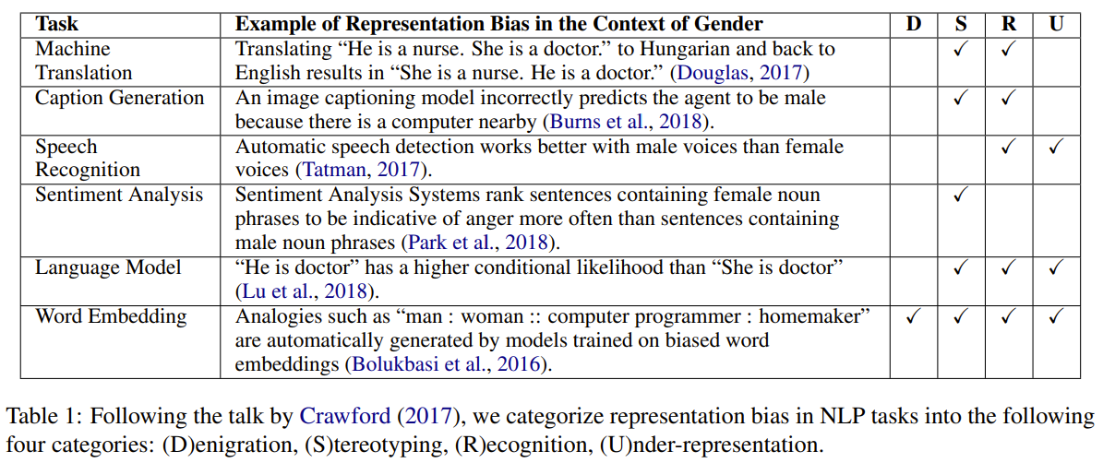
Similar findings in other datasets.
[1906.08976] Mitigating Gender Bias in Natural Language Processing: Literature Review (arxiv.org)

Slide 10
(3) Metric issue in XGLUE. (news title generation task)
INPUT: Three years ago, a man nicknamed "Murder" was charged in connection with a deadly home invasion in Bradenton. On Monday, Courtney Lawrence, 30, who also has "Murder" tattooed on his neck, pleaded guilty to second-degree murder with a firearm, attempted second-degree murder with a firearm, armed burglary of a dwelling with a firearm and possession of a firearm by a convicted felon. The Bradenton Herald reported in May 2016 that four or five armed men stormed a home and demanded money from the 38-year-old owner. Deputies say the homeowner and the gunman exchanged gunfire. The homeowner and one of the alleged gunmen, Emanuel Johnson, were injured in the shootout, and Johnson was later pronounced dead at a local hospital. The Miami Herald said Lawrence was identified as one of the alleged gunmen when he was dropped off at a local hospital within 30 minutes of the shooting. The Herald said he had gunshot wounds on his buttocks and an injury to his shoulder. An investigation from the Manatee County Sheriff's Office said Lawrence admitted he had been shot during an armed robbery and that an accomplice had been killed. Lawrence pleaded guilty Monday and was sentenced to 40 years in prison. What other people are reading right now: 85-year-old Florida man accused of murdering 90-year-old lover of 60 years Assisted living facility worker reportedly left residents alone to go clubbing Man missing after being carjacked by armed bank robber, deputies say 5-year-old SC girl missing after mom found dead in-home Ex-cardinal's letters show signs of grooming victims for abuse, experts say ► Make it easy to keep up-to-date with more stories like this. Download the 10News app now . Have a news tip? Email desk@wtsp.com or visit our Facebook page or Twitter feed .
GOLDEN: Florida man nicknamed 'Murder' pleads guilty to murder charges
GENERATED: Man with 'Murder' tattoo admit his guilt in deadly home invasion

Slide 11
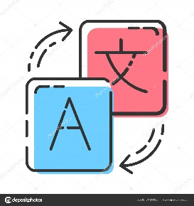
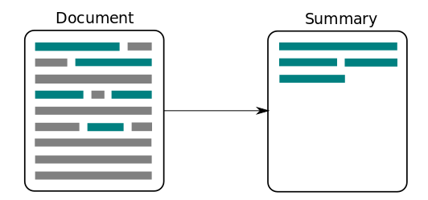
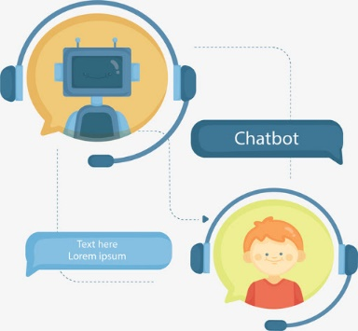
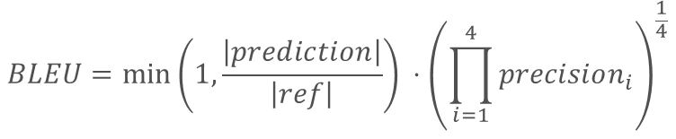
Similar findings in other datasets.
Machine Translation
$$BLEU=\min\left(1, \frac{\left|prediction\right|}{\left|ref\right|}\right) ⋅{\left(\prod_{i=1}^{4}{precision_{i}}\right)}^{\frac{1}{4}}$$
Text Summarization
Response Generation
doesn’t consider meaning
…
…

Slide 12
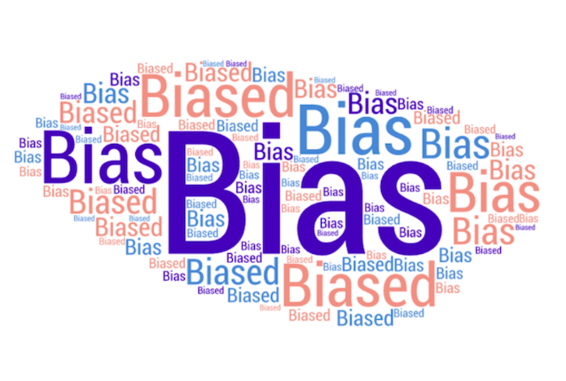

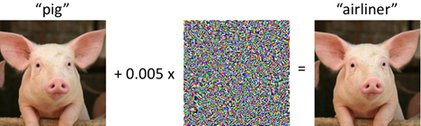
3 Issues of Current Benchmarks
Robustness Measurement
Data Bias
Evaluation Metric

Slide 13

3 Issues of Current Benchmarks
Robustness Measurement
Data Bias
Evaluation Metric

Slide 14
3 Issues of Current Benchmarks
Robustness Measurement
Data Bias
Evaluation Metric

Slide 15

Some Efforts to Robustness Measurement
Testing
Set
Target
Model
Incorrect
output
White-box
Method
Adversarial
Examples
Gradient, Parameter
Testing
Set
Target
Model
Incorrect
output
Black-box
Method
Adversarial
Examples
Score or Decision
Testing
Set
Target
Model
Incorrect
output
Blind-Box
Method
Adversarial
Examples

Slide 16
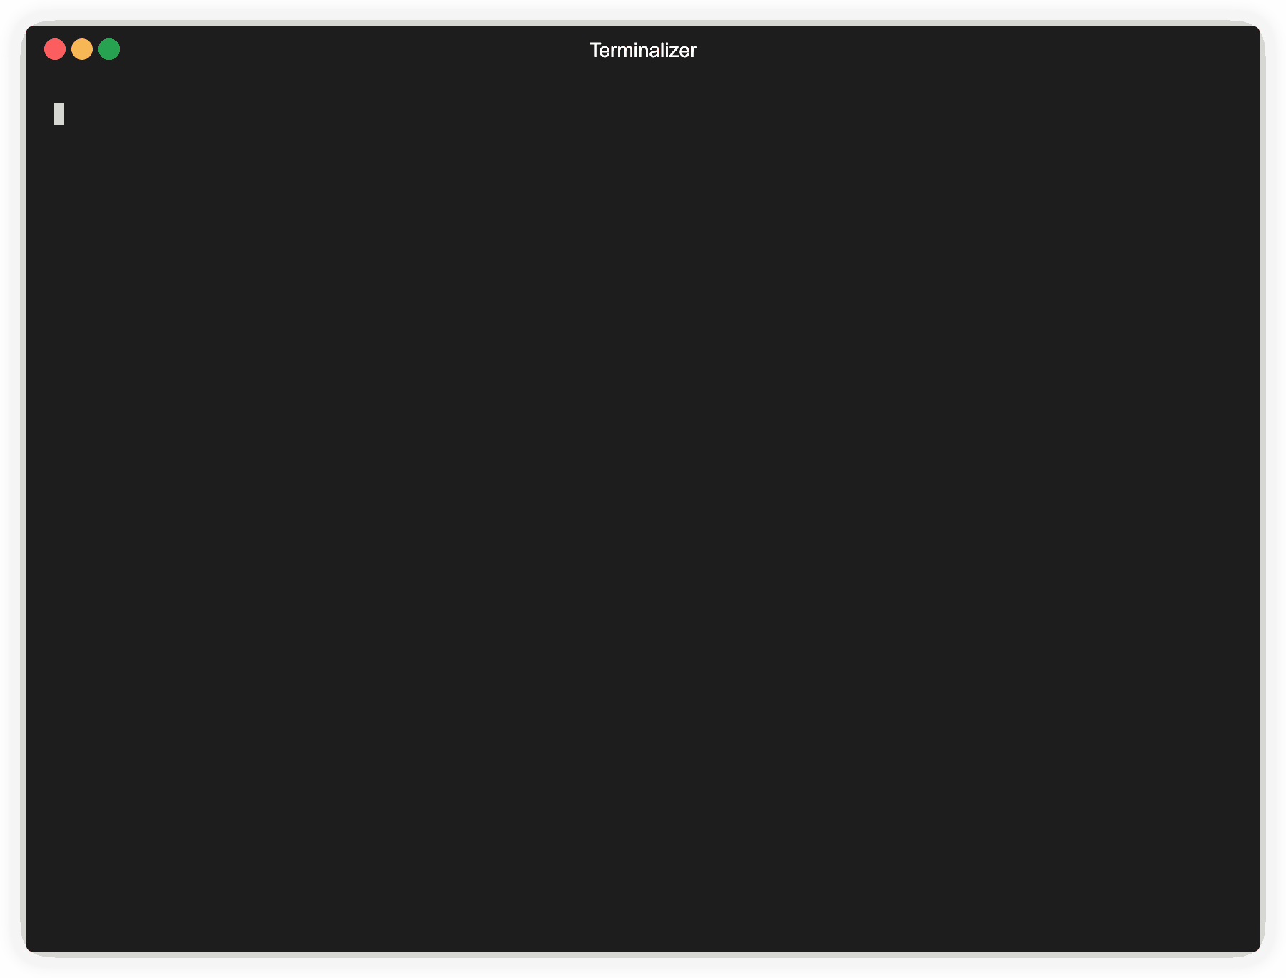
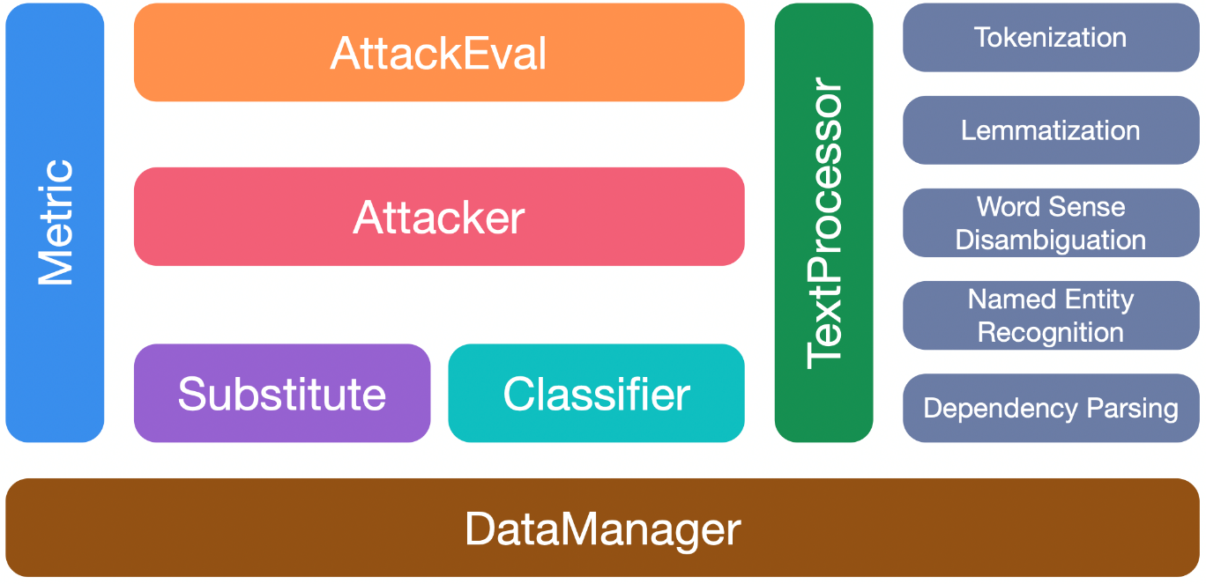
Some Efforts to Robustness Measurement
TextAttack 🐙
OpenAttack
Morris et al. TextAttack: A Framework for Adversarial Attacks, Data Augmentation, and Adversarial Training in NLP, EMNLP 2020
https://github.com/thunlp/OpenAttack

Slide 17
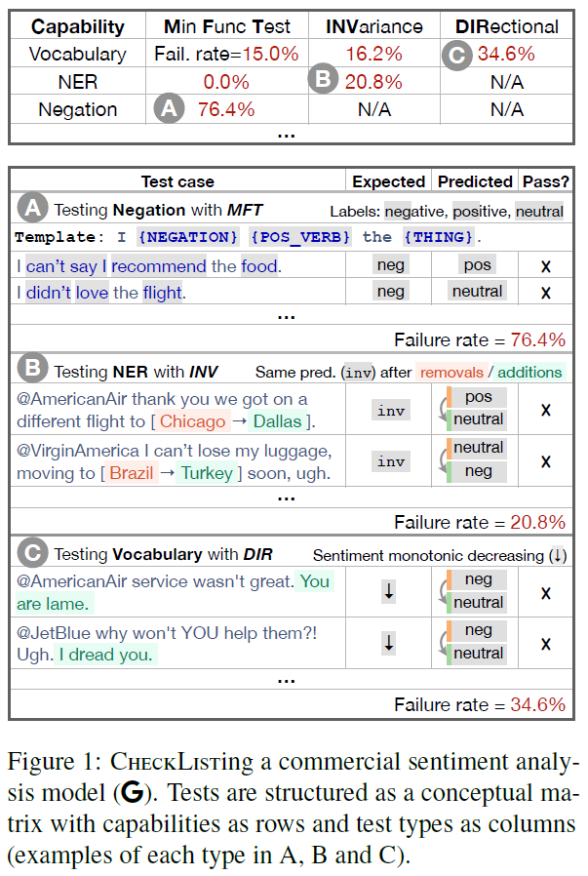
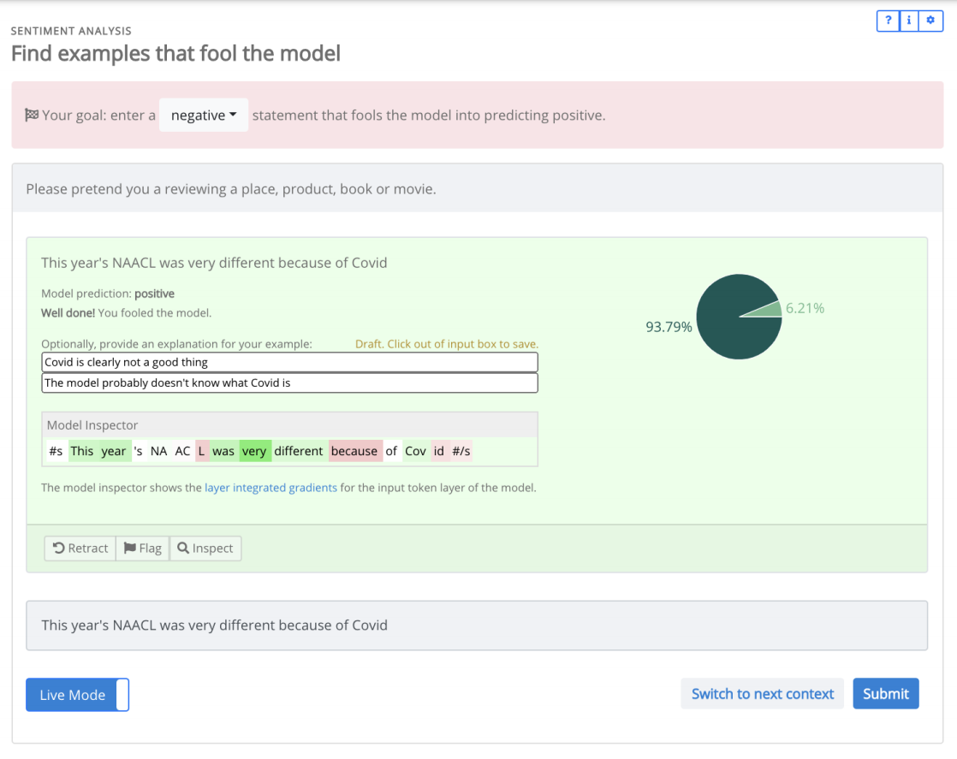


Some Efforts to Robustness Measurement
Ribeiro et al., Beyond Accuracy: Behavioral Testing of NLP Models with CheckList, ACL 2020
Kiela et al. Dynabench: Rethinking Benchmarking in NLP, NAACL 2021
Notes:
Dynabench is a platform which is build by Facebook AI. They proposed a human-and-model-in-the-loop dataset creation methodology.
They think that in most of time, we ultimately care not about a single benchmark, but about how well a method can work together with humans.
With recent progress, they think that models are good enough to be put in the loop with humans.

Slide 18

Some Efforts to Robustness Measurement
12 NLP Task
24 Classic Datasets
20 General transformations
60 Task-specific transformations
Wang et al., TextFlint: Unified Multilingual Robustness Evaluation Toolkit for Natural Language Processing, ACL 2021

Slide 19
Some Efforts to Robustness Measurement
Transformation - General
Synonym
“He loves NLP” --> “He likes NLP”
Antonym
John lives in Ireland → John doesn’t live in Ireland
Spelling Error
definitely → difinately
Typos
Shanghai → Shenghai
EntTypos
like → l1ke
OCR
Wang et al., TextFlint: Unified Multilingual Robustness Evaluation Toolkit for Natural Language Processing, ACL 2021

Slide 20
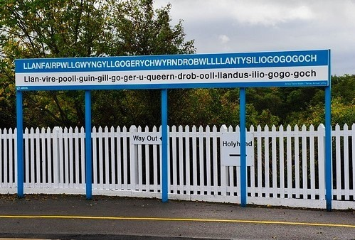
Some Efforts to Robustness Measurement
Transformation – Domain Specific
NER: SwapNamedEnt
“He was born in China” → “He was born in Llanfairpwllgwyngyllgogerychwyrndrobwllllantysiliogogogoch”
POS: SwapMultiPOS
“There is an apple on the desk” → “There is an imponderable on the desk”
Wang et al., TextFlint: Unified Multilingual Robustness Evaluation Toolkit for Natural Language Processing, ACL 2021

Slide 21
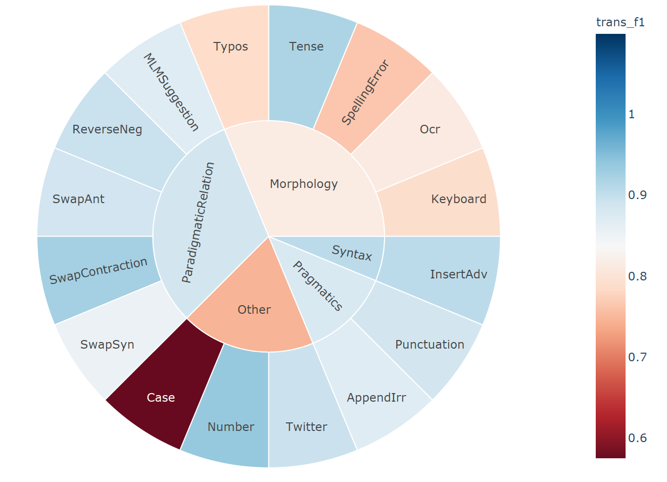
Some Efforts to Robustness Measurement
Wang et al., TextFlint: Unified Multilingual Robustness Evaluation Toolkit for Natural Language Processing, ACL 2021

Slide 22
3 Issues of Current Benchmarks
Robustness Measurement
Data Bias
Evaluation Metric

Slide 23
Some Efforts to Data Bias
WINOGRANDE
Large collection of WSC style challenge question pairs.
Inspired by WSC design
Much larger dataset
Higher difficulty questions
“Fill in the blank” format
Filtered to remove bias
Not all sentence questions have pairs
More diverse language used in questions
~44k questions before bias filtering, ~12k after
Sakaguchi et al., WINOGRANDE: An Adversarial Winograd Schema Challenge at Scale, AAAI 2020.
Notes:
To investigate this question about the true estimation of the machine commonsense capabilities, they introduced WINOGRANDE, a new dataset with 44k problems
They proposed an algorithm to generalize human-detectable biases based on word occurrences to machine-detectable biases based on embedding occurrences.
The effect of debiasing method is shown in the right figure. The figure plots RoBERTa pre-computed embeddings whose dimension is reduced to 2D (top) and 1D (bottom) using Principal Component Analysis (PCA). Data points are colored depending on the label (i.e., the answer y is option 1 (blue) or 2 (red)).
From the the figure, we can know that the original dataset is highly biased. Methods can easily find the decision boundary with surface patterns. Debiasing is an important step for constructing dataset.

Slide 24
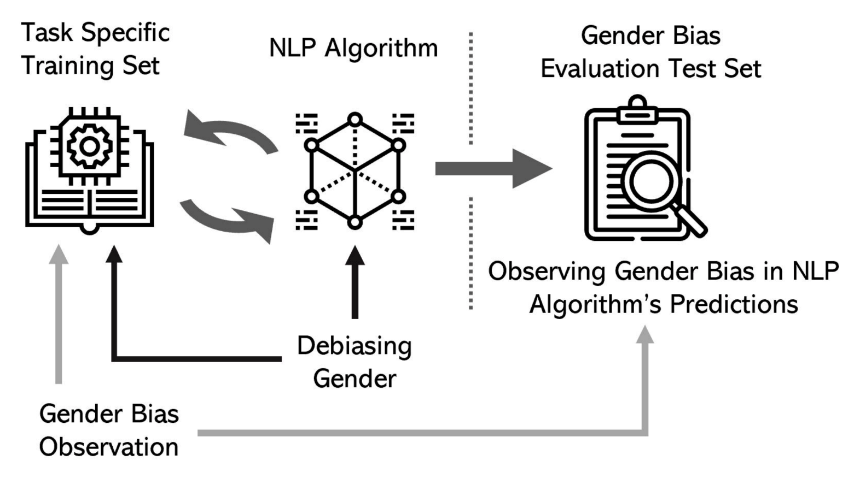
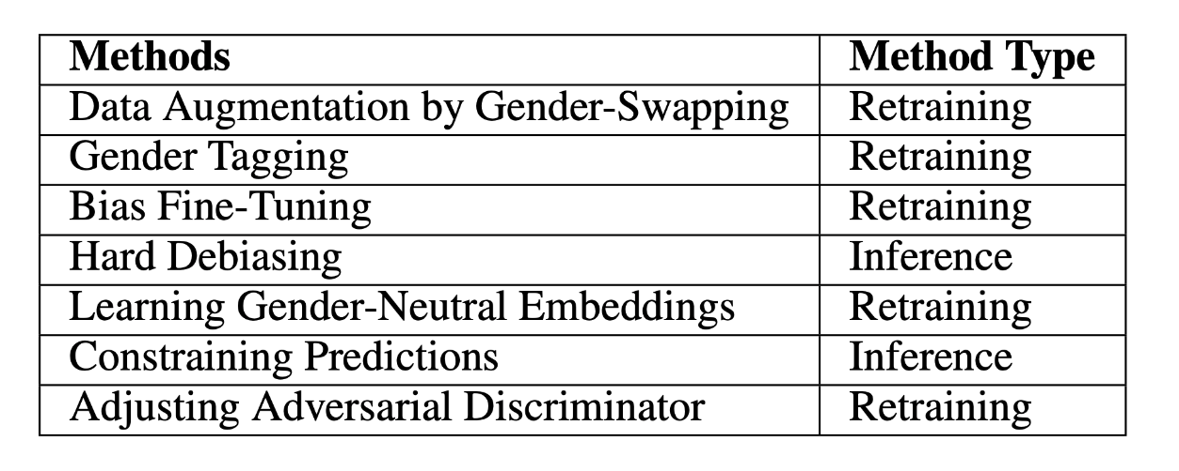
Some Efforts to Data Bias
Debiasing methods can be categorized according to how they affect the model.
Sun et al., Mitigating Gender Bias in Natural Language Processing: Literature Review, ACL 2019.

Slide 25
3 Issues of Current Benchmarks
Robustness Measurement
Data Bias
Evaluation Metric

Slide 26
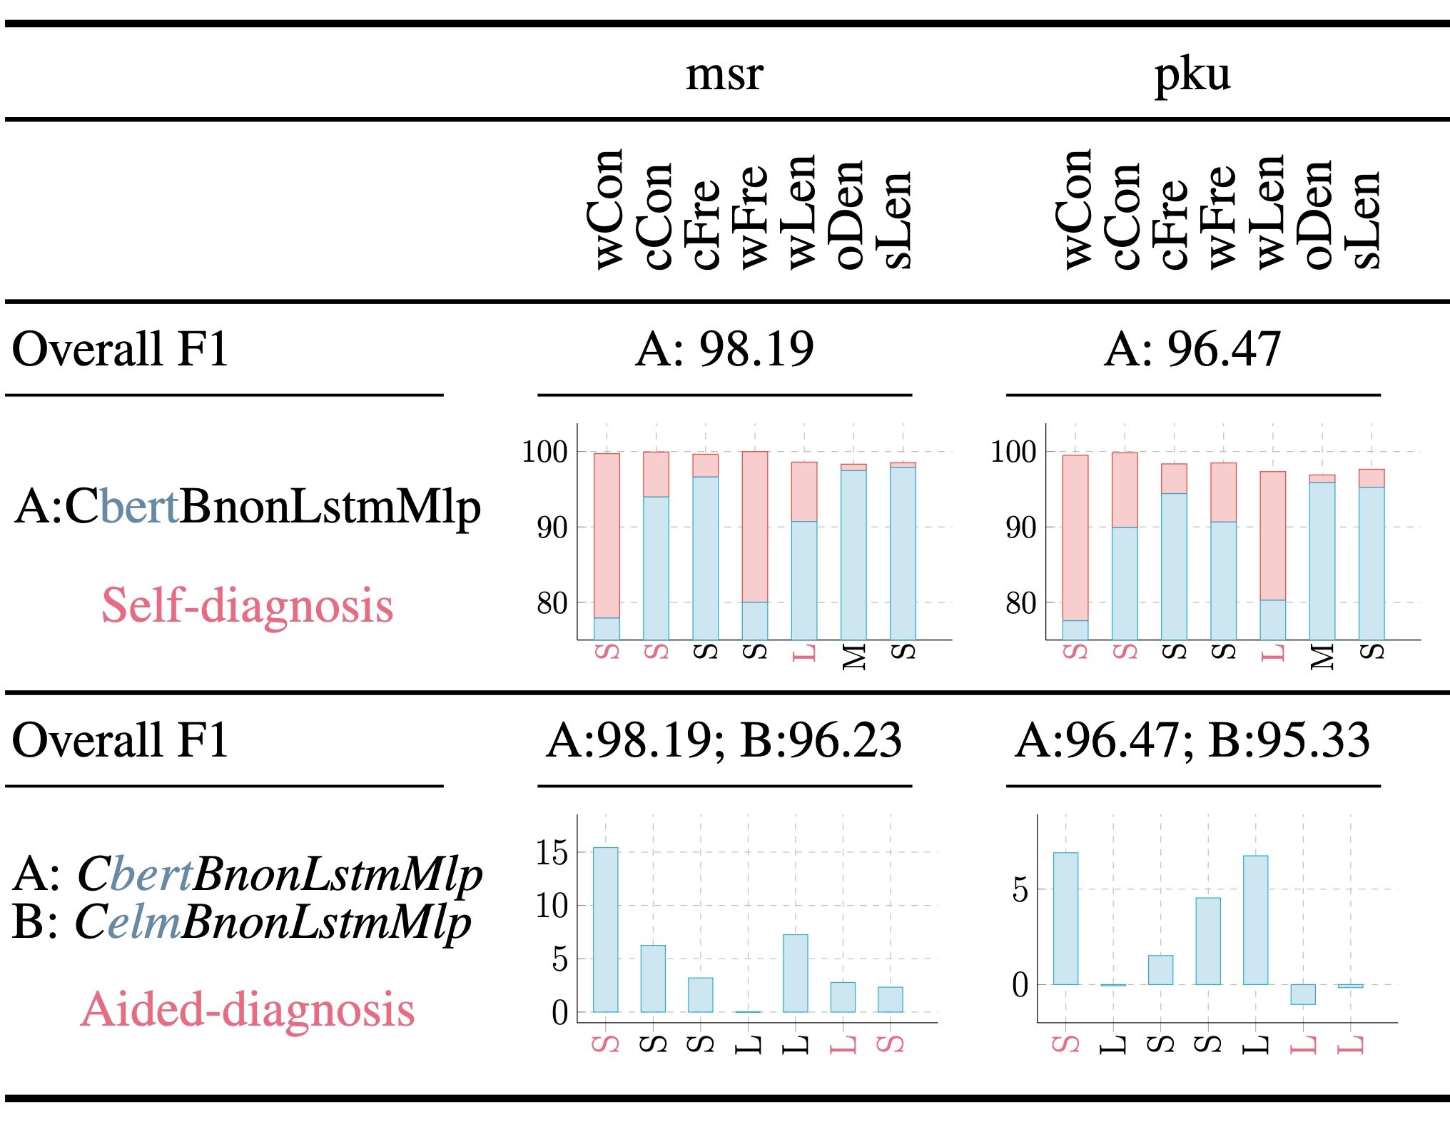
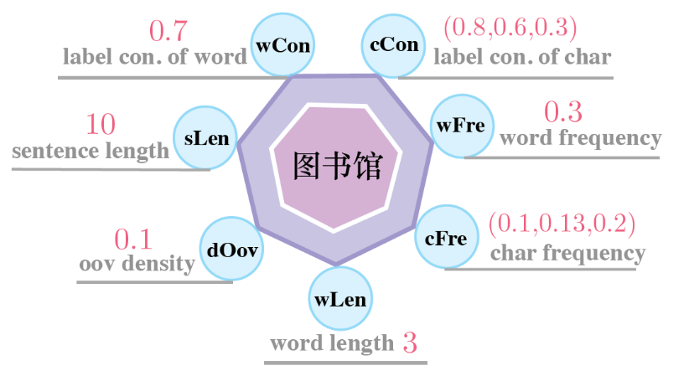
Some Efforts to Evaluation Metric
Aspect-I: Intrinsic nature
word length (wLen); sentence length (sLen)
OOV density (oDen);
Aspect-II: Familiarity
word frequency (wFre); character frequency (cFre)
Aspect-III: Label consistency
label consistency of word (wCon);
label consistency of character (cCon)
Self-diagnosis：aims to locate the bucket on which the input model has obtained the worst performance with respect to a given attribute.
Aided-diagnosis(A,B): aims to compare the performance of different models on different bucket.
Fu et al. , RethinkCWS: Is Chinese Word Segmentation a Solved Task?，EMNLP 2020

Slide 27
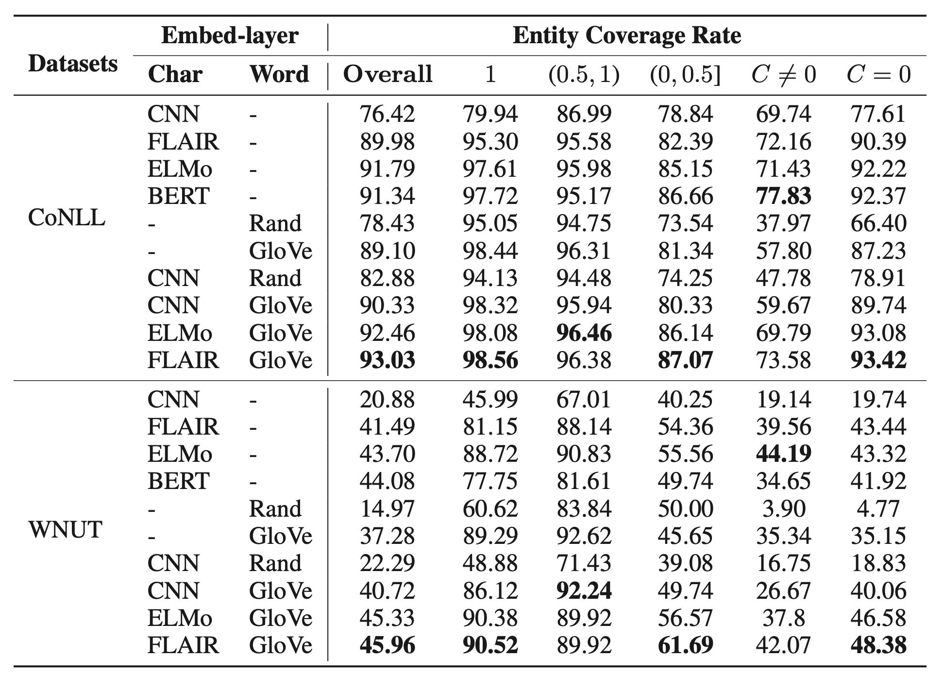
Some Efforts to Evaluation Metric
Entity Coverage Ratio (ECR) The measure entity coverage ratio is used to describe the degree to which entities in the test set have been seen in the training set with the same category.
Fu et al. , Rethinking Generalization of Neural Models: A Named Entity Recognition Case Study， AAAI 2020

Slide 28
References
Robustness
Ribeiro et al., Beyond Accuracy: Behavioral Testing of NLP Models with CheckList, ACL 2020
Kiela et al. Dynabench: Rethinking Benchmarking in NLP, NAACL 2021
Morris et al. TextAttack: A Framework for Adversarial Attacks, Data Augmentation, and Adversarial Training in NLP, EMNLP 2020
Wang et al., TextFlint: Unified Multilingual Robustness Evaluation Toolkit for Natural Language Processing, ACL 2021
Bias
Sakaguchi et al., WINOGRANDE: An Adversarial Winograd Schema Challenge at Scale, AAAI 2020.
Sun et al., Mitigating Gender Bias in Natural Language Processing: Literature Review, ACL 2019.
Evaluation
Fu et al. , RethinkCWS: Is Chinese Word Segmentation a Solved Task?，EMNLP 2020
Fu et al. , Rethinking Generalization of Neural Models: A Named Entity Recognition Case Study， AAAI 2020

Slide 29
Conclusion
Robustness
We should look beyond the simple and well-defined problems and pay more attention on the challenges of real-world systems. How to evaluate and improve the robustness of a model is one of these challenges.
Bias
Dataset-specific biases may highly impact the usefulness of model trained on it.
When we construct dataset, debiasing methods are not optional, are necessary.
Evaluation
After dataset is constructed, it would be better to manually perturb a small number test instances for further evaluation.
Task specific and attribute-aided evaluation metrics may help us diagnose the weaknesses of methods.

Slide 30
Thanks!

